Slide 1

Choosing Your Best Machine: Laptops Vs. Desktops for the Best Value and Use Case Under Various Constraints
By Gary Yu
https://linktr.ee/yu.2413 - Link in QR Code
BA – Economics, and Political Science (Foreign Affairs Focused)
Future Grad Student (Data Science, ECON or GIS)
Important: All of this will be on my GitHub Go to my Link tree to find it
Notes:
AI-generated content may be incorrect. --- This presentation explores the decision-making process between choosing laptops or desktops, focusing on delivering the best value based on use cases and time-sensitive needs for purchase and deployment.

Slide 2
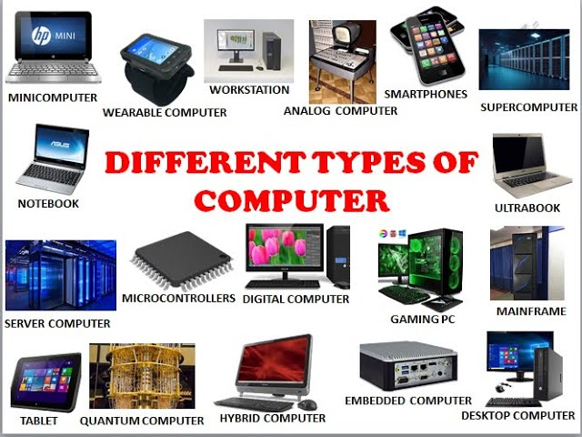
Table Of Contents
Defining Use Cases and Time Constraints
In-Depth Breakdown: Desktop Computers
In-Depth Breakdown: Laptops
Comparative Analysis: Desktop Vs. Laptop
Recommendations for Optimal Selection
Notes:
--- We will cover defining use cases and time constraints, detailed breakdowns of desktops and laptops, a comparative analysis between the two, and conclude with recommendations for making an optimal, timely choice. Image source: Microsoft 365 content library

Slide 3
Defining Use Cases and Time Constraints
Notes:
Understanding the specific user needs and computing scenarios is critical. We will analyze time constraints related to both purchase and deployment and establish evaluation criteria focusing on performance, portability, and cost.

Slide 4
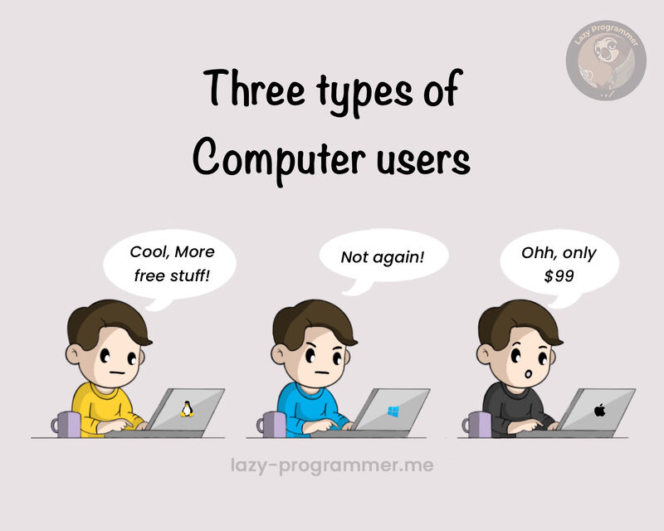
Understanding User Needs and Computing Scenarios
Varied User Requirements
Most personal users have different computing needs based on activities like work, gaming, hobbies, and other various uses.
Importance of Finding Your User Needs
You wouldn’t want to buy a Honda civic to do long haul shipping, nor would you want a tractor-trailer for Uber. Computers are no different. You don’t want to buy a computer that is underpowered, or a computer with a operating system(OS) you don’t like or are used to.
Notes:
--- Different users have varying requirements depending on work, gaming, portability, or multimedia needs. Properly identifying these needs helps guide the right machine selection. Image source: Microsoft 365 content library

Slide 5
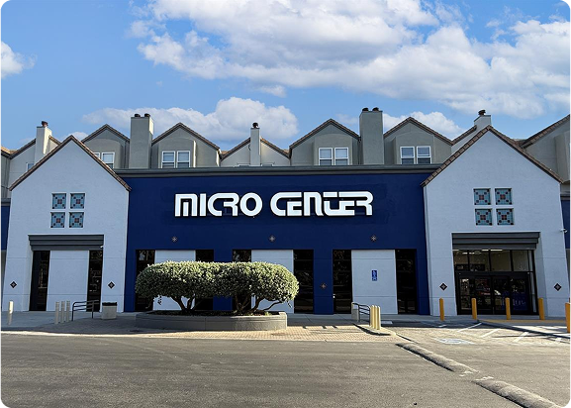
Analyzing Time Constraints for Purchase and Deployment
Impact of Time Constraints
Time restrictions determine how fast a machine must be purchased.
This can affect everything from price(I can hunt for a good deal longer) all the way to form factor(I wanted a laptop that has my favorite TV show’s design) all the way to give me a computer with these specs at this value to give me any computer with this graphics card.
Purchasing Factors
Price (<499, 500 – 999, 1000 – 1499, 1500 – 2499, 2500 +)
Specs
(laptop vs desktop, build quality, PSU, GPU, CPU, RAM, Motherboard, Storage(NVME SSD Gen 4 vs 5), color, number of ports, upgradability, Wi-Fi 6E vs Wi-Fi 7, PCIe slots or driver bays, brand, eco-system(IOS vs windows/Linux), etc.)
Notes:
--- Time constraints affect how quickly a machine must be sourced and ready for use. This section addresses factors influencing procurement speed and setup time. Image source: Microsoft 365 content library

Slide 6

Establishing Evaluation Criteria: Performance, Portability, and Cost
Performance
Computing power is essential to evaluate device efficiency and speed for various tasks.
Portability
Ease of transport helps determine the convenience of carrying laptops or desktops.
Cost
Budget considerations ensure the device meets financial constraints without sacrificing quality.
Notes:
--- We establish key criteria such as computing power, ease of transport, and budget considerations to objectively evaluate laptops and desktops under time pressure. Image source: Microsoft 365 content library

Slide 7
In-Depth Breakdown: Desktop Computers
Notes:
We examine desktop core components, their strengths and weaknesses, and identify the best desktop options across different budget ranges.

Slide 8
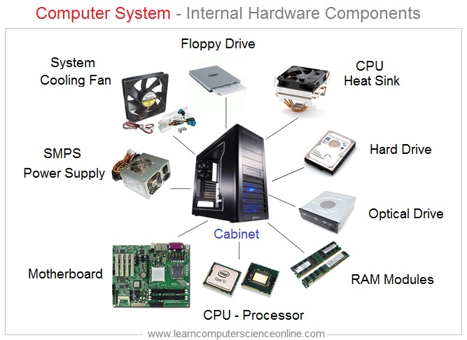
Core Components: CPU, GPU, RAM, Motherboard, Storage, and Power Supply
Central Processing Unit (CPU)
The CPU acts as the computer's brain, executing instructions and managing tasks for overall system performance. An example of a triopoly(Basically, Apple for macOS, and AMD vs Intel for PCs).
Graphics Processing Unit (GPU)
Dedicated GPUs process complex graphics and visuals, enhancing gaming and multimedia experiences. An example of an Oligopoly (Apple for NVidia, AMD, and Intel are the big three for non-IOS)
Random Access Memory (RAM)
RAM provides fast temporary data storage, enabling smooth multitasking and faster application access. (EX. 8 vs 16 vs 32 vs 64 vs 128 GB of ram.)
Motherboard and Power Supply
The motherboard connects all components, while the power supply delivers stable electricity to the system. Brands include MSI, ASUS, Gigabyte, and Asrock.
Notes:
--- Desktop systems typically include powerful CPUs, dedicated GPUs, ample RAM, customizable motherboards, large storage options, and robust power supplies enabling high performance. Image source: Microsoft 365 content library

Slide 9
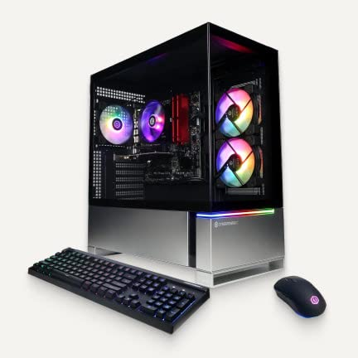
Advantages and Disadvantages of Desktops
Superior Performance
Desktops generally provide higher processing power and better performance for demanding tasks compared to portable devices.
Upgradeability
Desktops allow easy hardware upgrades, enabling users to enhance memory, storage, and graphics capabilities over time.
Lack of Portability
Due to their size and design, desktops are not portable, limiting their use to fixed locations.
Notes:
--- Desktops offer superior performance and upgradeability but lack portability. We'll examine these pros and cons in detail. Image source: Microsoft 365 content library

Slide 10
Best Desktop Options at Various Price Points
Entry-Level Desktops
Affordable desktops designed for basic tasks like web browsing and office work, ideal for budget-conscious users.
Mid-Range Desktops
Balanced performance desktops suitable for multitasking, gaming, and creative work without breaking the bank.
High-End Desktops
Premium desktops offering top-tier performance for demanding applications like video editing and 3D rendering.
Notes:
--- We review desktop configurations suitable for entry-level, mid-range, and high-end budgets, catering to diverse user needs. Image source: Microsoft 365 content library

Slide 11
In-Depth Breakdown: Laptops
Notes:
Next, we explore laptop components, their benefits and limits, alongside top laptop recommendations tailored for different budgets and requirements.

Slide 12

Core Components: Mobile CPU, Integrated/Discrete GPU, RAM, Storage, Battery, and Display
Mobile CPU Functionality
Mobile CPUs provide the processing power needed for laptop performance while optimizing battery life.
Integrated and Discrete GPUs
Laptops use integrated or discrete GPUs for graphics rendering, balancing performance and energy efficiency.
RAM and Storage Components
RAM enables multitasking, while storage holds data and applications for quick access in laptops.
Battery and Display Importance
Batteries provide mobility and displays offer user interaction with clear visuals and power efficiency.
Notes:
--- Laptops integrate mobile CPUs, either integrated or discrete GPUs, RAM, storage, batteries for mobility, and displays—balancing power and portability. Image source: Microsoft 365 content library

Slide 13
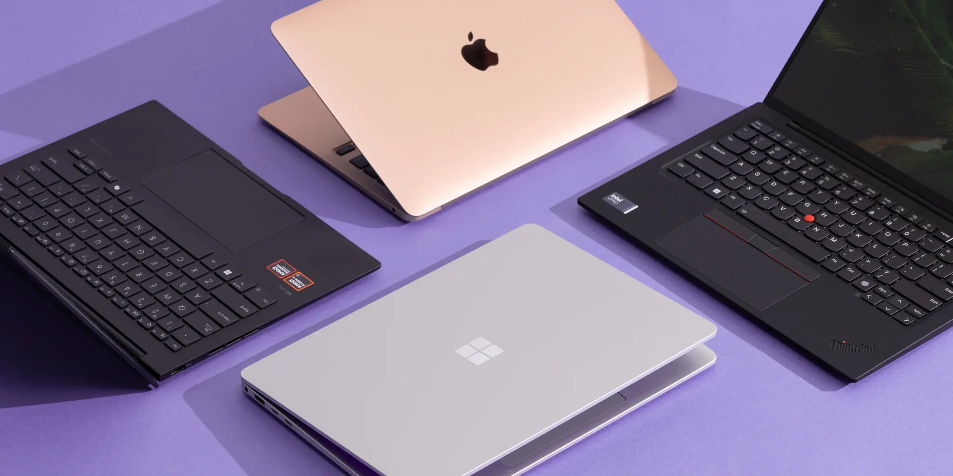
Advantages and Disadvantages of Laptops
Portability and Energy Efficiency
Laptops offer excellent portability and consume less energy, making them ideal for mobile use and extended battery life.
Performance Limitations
Compared to desktops, laptops may have lower raw performance due to compact hardware design and thermal constraints.
Upgrade Constraints
Laptops have limited upgrade options, restricting hardware enhancements compared to desktop computers.
Notes:
--- Laptops excel in portability and energy efficiency but might face compromises in raw performance and upgrade options compared to desktops. Image source: Microsoft 365 content library

Slide 14

Best Laptop Choices for Different Budgets and Needs
Budget-Friendly Laptops
Affordable laptops that offer essential features and good performance for everyday tasks and basic computing needs.
Professional Use Laptops
High-performance laptops designed for business professionals focusing on productivity, reliability, and multitasking.
Gaming Laptops
Powerful laptops equipped with advanced graphics and cooling systems for immersive gaming experiences.
Ultramobile Laptops
Lightweight and portable laptops designed for users who prioritize mobility and long battery life.
Notes:
--- We present laptop models optimized for budget constraints, professional use, gaming, and ultramobility, helping users find the right fit. Image source: Microsoft 365 content library

Slide 15
Comparative Analysis: Desktop Vs. Laptop
Notes:
This section compares desktops and laptops head-to-head on performance, portability, and cost-benefit to inform balanced decisions.

Slide 16

Performance Comparison Across Use Cases
Gaming Performance
Desktops generally offer higher performance for gaming due to better cooling and powerful hardware.
Content Creation
Both desktops and laptops support content creation, but desktops often provide faster processing and larger displays.
General Productivity
Laptops offer convenience and portability for general productivity tasks without sacrificing essential performance.
Portability Tasks
Laptops excel in portability-demanding tasks, enabling work on the go with lightweight designs.
Notes:
--- We analyze how desktops and laptops perform in scenarios like gaming, content creation, general productivity, and portability-demanding tasks. Image source: Microsoft 365 content library

Slide 17

Portability and Convenience Factors
Laptop Portability
Laptops are easy to carry and use on the go, providing mobility and convenience for users.
Desktop Convenience
Desktops offer easier upgrades and repairs due to accessible components and modular design.
Notes:
--- Portability is a strength of laptops, while desktops provide convenience in upgrade and repair. This slide explores these factors. Image source: Microsoft 365 content library

Slide 18
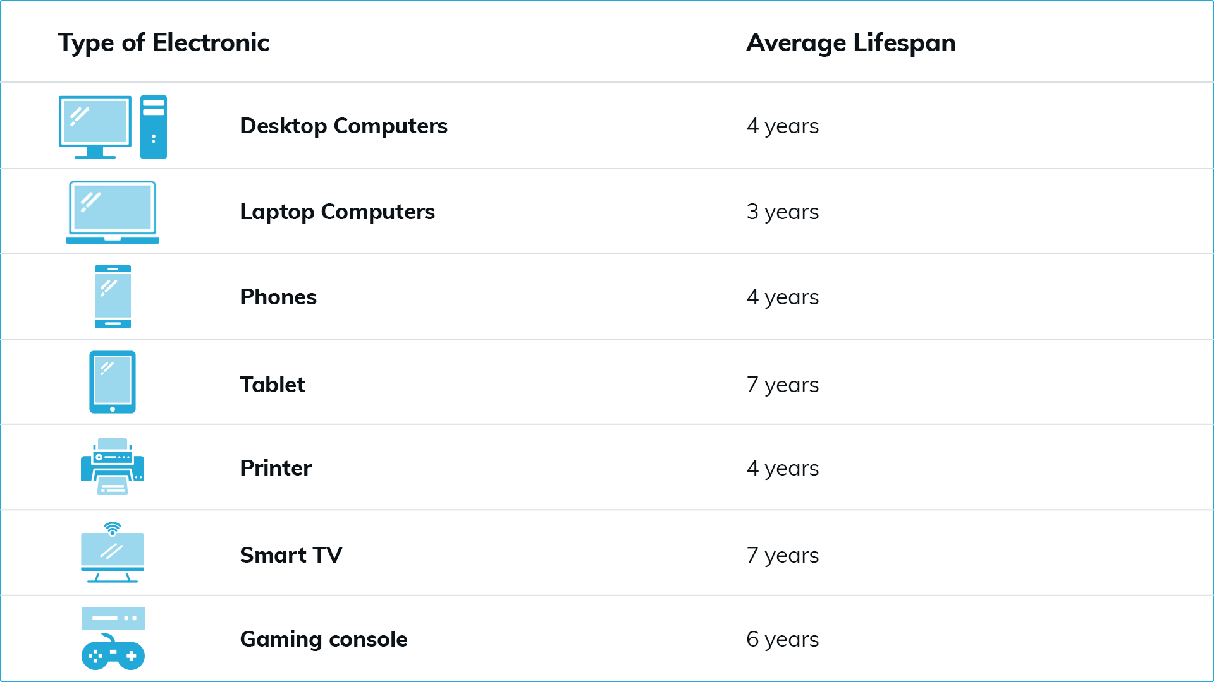
Cost-Benefit Analysis and Long-Term Value
Initial Cost Comparison
Assess the upfront purchase prices for desktops and laptops to understand budget requirements.
Lifespan and Durability
Evaluate the expected usage duration and durability of desktops versus laptops.
Maintenance and Upgrades
Consider maintenance costs and ease of upgrading components over time for both devices.
Notes:
--- Consideration of initial cost, lifespan, maintenance, and potential upgrades impacts the overall value proposition of desktops versus laptops. Image source: Microsoft 365 content library

Slide 19
Recommendations for Optimal Selection
Notes:
Finally, we provide practical guidelines to choose the ideal machine based on priorities, quick-purchase tips under tight timelines, and highlight best value picks.

Slide 20

Guidelines for Choosing Based on User Priorities
Performance Priority
Choose solutions optimized for high performance when speed and efficiency are critical.
Portability Priority
Opt for lightweight and compact options when ease of transport matters most.
Cost Priority
Select cost-effective options to balance budget constraints with required functionality.
Rapid Deployment Priority
Focus on solutions that enable quick setup and fast implementation.
Notes:
--- Recommendations depend on whether performance, portability, cost, or rapid deployment is most critical to the user’s context. Image source: Microsoft 365 content library

Slide 21

Quick-Purchase Strategies Under Tight Timelines
Expedited Purchase Decisions
Relying on pre-configured models(Prebuilt) accelerates decision-making and shortens procurement cycles.
Trusted Vendor Partnerships
Working with trusted vendors ensures quicker deployment and reliable product delivery.
Notes:
--- We suggest strategies to expedite purchase decisions and deployment, including relying on pre-configured models and trusted vendors. Image source: Microsoft 365 content library

Slide 22
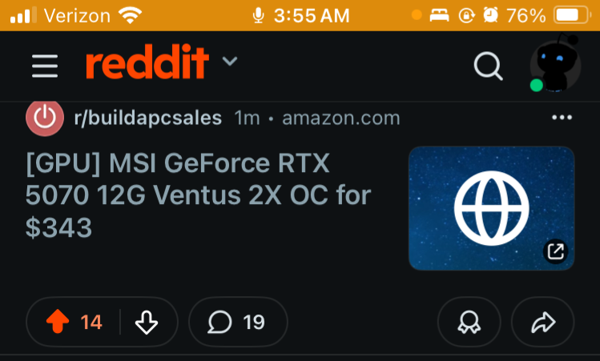
Highlighting Best Value Picks for Common Scenarios
Top Laptop Models
Summarizes laptops that provide excellent value for everyday use under limited time constraints.
Best Desktop Picks
Highlights desktop computers offering the best performance and value for general scenarios.
Use Case Efficiency
Focuses on models optimized to handle typical tasks efficiently within limited time frames.
Notes:
--- This slide summarizes top laptop and desktop models that deliver the best value for typical use cases under time constraints. Image source: Microsoft 365 content library

Slide 23
Conclusion
Balancing Key Factors
Choosing between laptops and desktops requires balancing performance, portability, cost, and timing for optimal value.
Understanding Needs
Assess your specific needs and constraints to make an informed choice that fits your use case perfectly.
Notes:
Choosing between laptops and desktops involves balancing performance, portability, cost, and timing. By understanding your needs and constraints, you can make an informed decision that offers the best value and fits your use case perfectly.

Slide 24
Computer Deal Links
Reddit – r/buildapcsales (Best One if a post/deal has more upvotes than downvotes, and the best comments approve)
Woot - https://www.woot.com/ (Great Used Deals)
Amazon - https://www.amazon.com/ (Hit or Miss and watch out for the brand)
Micro-Center Website - https://www.microcenter.com/ (Amazing)
Newegg - https://www.newegg.com/ (Hit or Miss)
Costco - https://www.costco.com/ (Hit or Miss)
Best Buy - https://www.bestbuy.com/home (Sometimes)
Walmart - https://www.walmart.com/ (Low to Medium tier deals)
Notes:
Choosing between laptops and desktops involves balancing performance, portability, cost, and timing. By understanding your needs and constraints, you can make an informed decision that offers the best value and fits your use case perfectly.

